Slide 1


Milk Tea Shop Management with Inventory System

Slide 2
INTRODUCTION:
In todays rapidly moving environment, milk tea has become very popular across many countries. Improving costumer experience is important in the food and beverage industry and to stay competitive, businesses need to enhance customer experience both in-store and online. The milk tea industry is increasing, more people want their orders to be more convenient and personalized. With the digital trends changing how people order, milk tea shops are now using new systems to meet their demand. This system focuses on identifying the gaps in the current customer experience and providing technological solutions to address these challenges, ultimately improving overall customer satisfaction and efficient business operations.

Slide 3
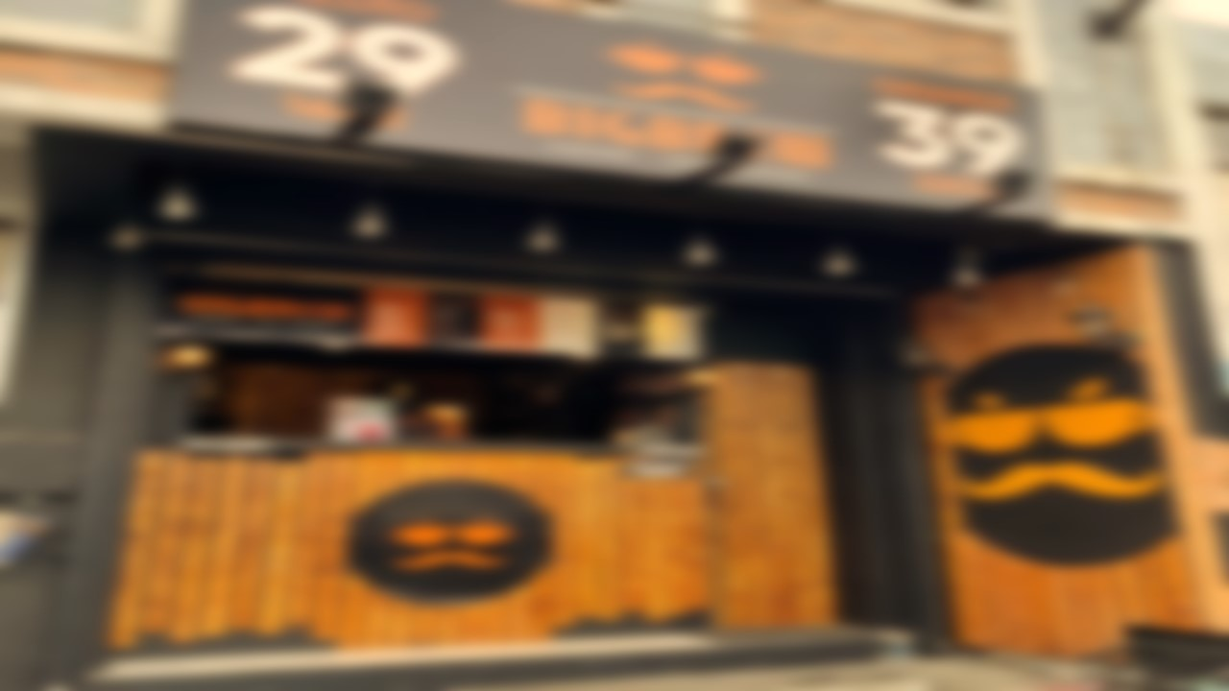
BACKGROUND OF THE STUDY:
The milk tea industry is experiencing continuous growth as more consumers seek convenient, efficient, and personalized ordering experiences. With people increasingly valuing speed and customization in their food and beverage choices, businesses are recognizing the importance of meeting these evolving expectations.
This system will bridge the gap between current milk tea ordering management and customer expectations by implementing modern technology to create a smoother, more enjoyable experience for both customers and businesses.

Slide 4
PURPOSE:
The purpose of this system is to improve the overall experience through a milk tea management with inventory system. By making it more convenient and personalized to meet the needs of both costumer and businesses.

Slide 5
PROJECT CONTEXT:
One area where many milk tea shops struggle is in the ordering process, both in-store and online.Poor management, long queues, errors in orders, lack of customization, and inefficient payment processes are common user problem. This system aims to address the existing gaps in current ordering processes and introduce a solution that enhances customer and staff satisfaction.
Features:
Customization: Customers can choose size, sugar levels, and quantity
Payment Options: Multiple payment modes for greater convenience.
Order Verification: Cashiers can easily confirm orders and minimize errors.
Sales Reporting: Admins can track sales data by searching for specific dates, improving business decision-making
Inventory and Employee Management: Admins can add, edit, and delete records to keep the system organized.

Slide 6
OBJECTIVES:
Improve Customer Experience: Provide a more personalized and convenient milk tea ordering process tailored to individual preferences.
Operational Efficiency: Improve the ordering process, managing stocks, sales processing, customer and employee management, speeding up service and reducing errors.
Technological Integration: Use digital tools to meet the growing demand for milk tea ordering.
Admin and Cashier Tools: Enable cashiers to verify orders efficiently, while providing admins with the capability to manage the staff, inventory, review sales and generate reports for specific staffs.
Customer Loyalty: Drive customer support by offering a seamless, enjoyable ordering experience that meets modern expectations.

Slide 8



USERNAME:
Ma23015610
PASSWORD:
*******
Show Password
LOGIN
Forgot password

Slide 9
FORGOT PASSWORD
Enter your email or phone number:
Enter

Slide 10
FORGOT PASSWORD
Enter One Time Password
(OTP)
1789
58s
Didn’t receive the code? Re-send OTP
VERIFY

Slide 11
FORGOT PASSWORD
Enter new password
Confirm Password
CHANGE

Slide 12
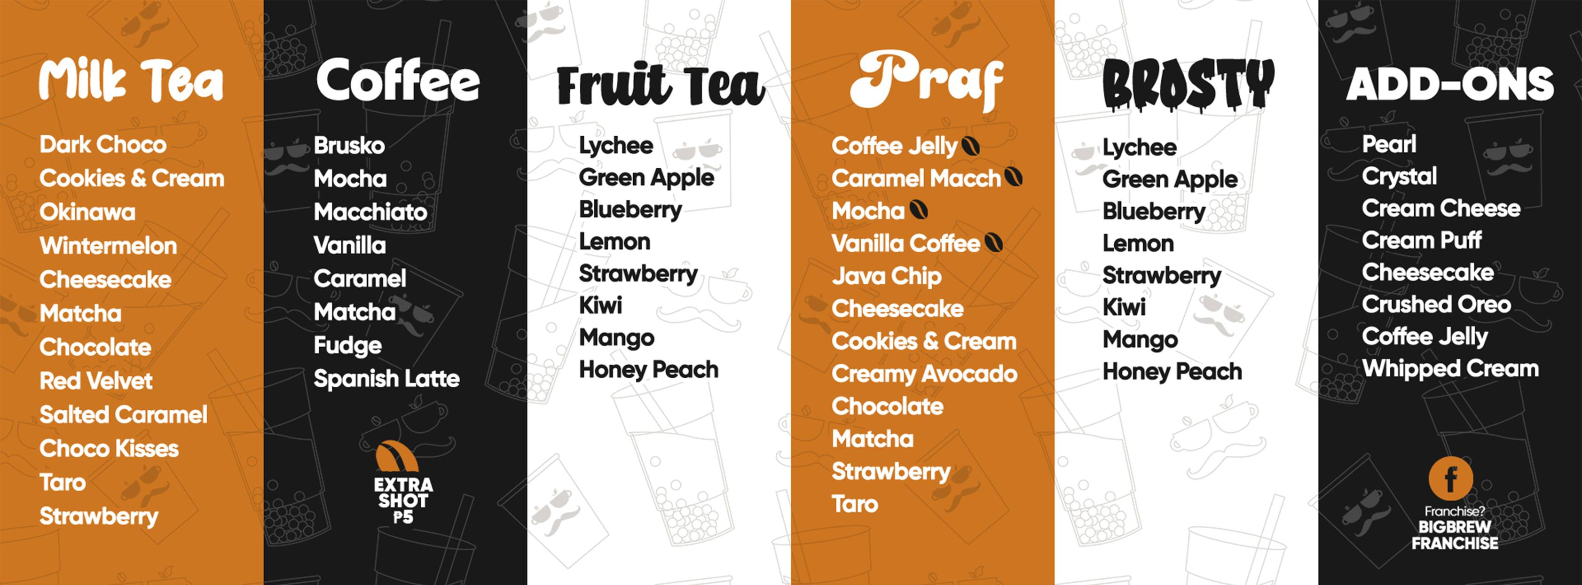
MILK TEA SHOP MANAGEMENT WITH INVENTORY SYSTEM
HOME
ORDERS
SALES
INVENTORY
PROFILE
ABOUT US

Slide 13
MILK TEA SHOP MANAGEMENT WITH INVENTORY SYSTEM
Order number:
HOME
PRODUCT NUMBER | DATE | PRODUCT NAME | SIZE | QUANTITY | PRICE | TOTAL | STATUS
2471 | 10/4/24 | Mango fruit tea | 22 oz | 3 | 39 | 117 | Pending
Confirm
ORDERS
SALES
INVENTORY
PROFILE
ABOUT US
Edit
Delete

Slide 14
MILK TEA SHOP MANAGEMENT WITH INVENTORY SYSTEM
Order number:
HOME
PRODUCT NUMBER | DATE | PRODUCT NAME | SIZE | QUANTITY | PRICE | TOTAL | STATUS
2471 | 10/4/24 | Mango fruit tea | 22 oz | 3 | 39 | 117 | Ordered Complete
ORDERS
SALES
INVENTORY
PROFILE
ABOUT US
Edit
Delete

Slide 15

MILK TEA SHOP MANAGEMENT WITH INVENTORY SYSTEM
Search:
STAFF | DATE | PRODUCT NAME | SIZE | QUANTITY | PRICE | TOTAL SALE
Adrian Villafuerte | OCTOBER 3,2024 | MATCHA | 22oz | 45 | Php 39.00 | Php 1.755.00
Adrian Villafuerte | OCTOBER 3,2024 | VANILLA | 16oz | 59 | Php 29.00 | Php 1,711.00
Adrian Villafuerte | OCTOBER 3,2024 | LYCHEE | 22oz | 100 | Php 39.00 | Php 3,900.00
Adrian Villafuerte | OCTOBER 3,2024 | WINTERMELON | 22oz | 121 | Php 39.00 | Php 4,719.00
Adrian Villafuerte | OCTOBER 3,2024 | BRUSKO | 16oz | 25 | Php 29.00 | Php 725.00
Adrian Villafuerte | OCTOBER 3,2024 | GREEN APPLE | 22oz | 18 | Php 59.00 | Php 1,062.00
HOME
ORDERS
SALES
INVENTORY
PROFILE
ABOUT US

Slide 16
MILK TEA SHOP MANAGEMENT WITH INVENTORY SYSTEM
Search:
PRODUCT # | PRODUCT NAME | SIZE/KG | QUANTITY | AMOUNT
1 | Red Velvet | 22oz | 45 | Php 1,500.00
2 | Salted Caramel | 1KG | 20 | Php 100.00
3 | Choco Kisses | 1KG | 20 | Php 300.00
4 | Strawberry | 1KG | 20 | Php 400.00
5 | Chocolate | 1KG | 20 | Php 160.00
6 | Matcha | 3KG | 25 | Php 160.00
7 | Okinawa | 3KG | 25 | Php 160.00
8 | Winter Melon | 3KG | 25 | Php 160.00
9 | Dark Choco | 3KG | 25 | Php 160.00
10 | Taro | 3KG | 25 | Php 160.00
11 | Cheesecake | 3KG | 25 | Php 160.00
12 | Choco Hazelnut | 3KG | 25 | Php 160.00
13 | Double Dutch | 3KG | 25 | Php 160.00
HOME
ORDERS
SALES
INVENTORY
PROFILE
ABOUT US

Slide 17

MILK TEA SHOP MANAGEMENT WITH INVENTORY SYSTEM
HOME
ORDERS
Name: Adrian Villafuerte
Email: Adrian@gmail.com
Birthdate: September 4, 2005
Address: Santor, Malolos
Username: Eydri
Contact no. : 093654633
Password: **********
SALES
INVENTORY
PROFILE
EDIT PROFILE
ABOUT US

Slide 18
MILK TEA SHOP MANAGEMENT WITH INVENTORY SYSTEM
HOME
ORDERS
Name:
Email:
Birthdate:
Address:
Username:
Contact no.:
Password: ********
Eydri Villafuerte
Ey@gmail.com
SALES
November 7,2024
Bangkal, Malolos
INVENTORY
Pogi
123456789
PROFILE
SAVE
ABOUT US

Slide 19
MILK TEA SHOP MANAGEMENT WITH INVENTORY SYSTEM
HOME
ORDERS
Name:
Email:
Birthdate:
Address:
Username:
Contact no.:
Password: ********
Eydri Villafuerte
Ey@gmail.com
SALES
Are you sure you want to change your information?
November 7,2024
Bangkal, Malolos
YES
NO
INVENTORY
Pogi
123456789
PROFILE
SAVE
ABOUT US

Slide 20
MILK TEA SHOP MANAGEMENT WITH INVENTORY SYSTEM
HOME
ORDERS
Name:
Email:
Birthdate:
Address:
Username:
Contact no.:
Password: ********
Eydri Villafuerte
Ey@gmail.com
SALES
November 7,2024
Information Successfully Change
Bangkal, Malolos
INVENTORY
Pogi
OK
123456789
PROFILE
SAVE
ABOUT US

Slide 21
MILK TEA SHOP MANAGEMENT WITH INVENTORY SYSTEM
HOME
ORDERS
Name: Eydri Villafuerte
Email: Ey@gmail.com
Birthdate: November 7, 2005
Address: Bangkal, Malolos
Username: Pogi
Contact no.: 123456789
Password: **********
SALES
INVENTORY
PROFILE
EDIT PROFILE
ABOUT US

Slide 22

MILK TEA SHOP MANAGEMENT WITH INVENTORY SYSTEM
Account Settings
HOME
ORDERS
Change Password
SALES
INVENTORY
PROFILE
ABOUT US
LOGOUT

Slide 23
MILK TEA SHOP MANAGEMENT WITH INVENTORY SYSTEM
HOME
Account Settings
Enter Current Password:
ORDERS
adrian123
SALES
Enter New Password:
Eydri321
INVENTORY
Confirm Password:
Eydri321
PROFILE
Save Changes
Back
ABOUT US

Slide 24
MILK TEA SHOP MANAGEMENT WITH INVENTORY SYSTEM
HOME
Account Settings
Enter Current Password:
ORDERS
adrian123
SALES
Enter New Password:
Are you sure you want to change your password?
Eydri321
YES
NO
INVENTORY
Confirm Password:
Eydri321
PROFILE
ABOUT US

Slide 25
MILK TEA SHOP MANAGEMENT WITH INVENTORY SYSTEM
HOME
Account Settings
Enter Current Password:
ORDERS
adrian123
SALES
Enter New Password:
Password Successfully Change
Eydri321
INVENTORY
OK
Confirm Password:
Eydri321
PROFILE
ABOUT US

Slide 26
MILK TEA SHOP MANAGEMENT WITH INVENTORY SYSTEM
Our Mission
Our mission is to revolutionize how you enjoy milk tea. We aim to make the ordering process as convenient and enjoyable as possible, offering a wide variety of flavors, toppings, and customization options for every taste. With our innovative platform, we hope to turn every milk tea order into a personal experience, allowing you to discover and savor new flavors, while ensuring top-notch quality and service.
Join Us on Our Journey!
Thank you for choosing Milk Tea Ordering System. We are constantly improving our system to serve you better and welcome your feedback. Whether you're an occasional tea drinker or a daily milk tea enthusiast, we are here to ensure that every cup brings happiness and satisfaction.
Explore. Order. Enjoy.
HOME
Who We Are
At Milk Tea Hub, we believe that ordering milk tea should be as enjoyable as drinking it. Founded by a group of passionate tea enthusiasts, we’ve combined our love for technology and milk tea to create a user-friendly platform that caters to tea lovers everywhere. Whether you're at home, at the office, or on the go, our system allows you to customize your orders, explore new flavors, and get your favorite drinks prepared for quick pick-up.
ORDERS
SALES
Why Choose Us?
- Convenient Ordering: With just a few taps, you can explore our diverse menu, customize your drink, and place your order in seconds.
- Wide Variety: From classic milk teas to fruit-based teas and innovative seasonal flavors, we have something for every milk tea lover.
- Customizable Options: Choose your preferred sugar level, ice level, sizes to create a drink that perfectly suits your taste.
- Fast & Reliable Service: We value your time. Whether it's for pick-up, we ensure your milk tea is made fresh.
- Secure Payments: Our platform supports multiple payment options, ensuring a hassle-free and secure checkout process.
Our Vision
We envision a world where enjoying your favorite milk tea is as simple as pushing a button. By combining technology with our passion for tea, we aim to create a platform that not only offers convenience but also a sense of connection. Whether you’re discovering a new flavor or sticking to a timeless favorite, our goal is to make every order special
INVENTORY
PROFILE
ABOUT US

Slide 28
USERNAME:
Jireh
PASSWORD:
********
Show Password
LOGIN
Forgot Password

Slide 29
FORGOT PASSWORD
Enter your email or phone number:
Enter

Slide 30
FORGOT PASSWORD
Enter One Time Password
(OTP)
1789
58s
Didn’t receive the code? Re-send OTP
VERIFY

Slide 31
FORGOT PASSWORD
Enter new password
Confirm Password
CHANGE

Slide 32
MILK TEA SHOP MANAGEMENT WITH INVENTORY SYSTEM
JIREH FRANCIA
HOME
SALES
INVENTORY
STAFF
PROFILE
ABOUT US

Slide 33
MILK TEA SHOP MANAGEMENT WITH INVENTORY SYSTEM
Search:
HOME
STAFF | DATE | ORDER NUMBER | PRODUCT NAME | SIZE | QUANTITY | PRICE | TOTAL SALE
Adrian Villafuerte | OCTOBER 3,2024 | 2017 | MATCHA | 22oz | 45 | Php 39.00 | Php 1.755.00
Adrian Villafuerte | OCTOBER 3,2024 | 1032 | VANILLA | 16oz | 59 | Php 29.00 | Php 1,711.00
Adrian Villafuerte | OCTOBER 3,2024 | 5798 | LYCHEE | 22oz | 100 | Php 39.00 | Php 3,900.00
Adrian Villafuerte | OCTOBER 3,2024 | 2010 | WINTERMELON | 22oz | 121 | Php 39.00 | Php 4,719.00
Adrian Villafuerte | OCTOBER 3,2024 | 2471 | BRUSKO | 16oz | 25 | Php 29.00 | Php 725.00
Adrian Villafuerte | OCTOBER 3,2024 | 2472 | GREEN APPLE | 22oz | 18 | Php 59.00 | Php 1,062.00
SALES
INVENTORY
STAFF
PROFILE
ABOUT US

Slide 34
MILK TEA SHOP MANAGEMENT WITH INVENTORY SYSTEM
Search:
PRODUCT # | TYPE | PRODUCT NAME | SIZE/KG | QUANTITY | AMOUNT
1 | Milktea | Red Velvet | 22oz | 45 | Php 1,500.00
2 | Milktea | Salted Caramel | 1KG | 20 | Php 100.00
3 | Milktea | Choco Kisses | 1KG | 20 | Php 300.00
4 | Milktea | Strawberry | 1KG | 20 | Php 400.00
5 | Milktea | Chocolate | 1KG | 20 | Php 160.00
6 | Milktea | Matcha | 3KG | 25 | Php 160.00
7 | Milktea | Okinawa | 3KG | 25 | Php 160.00
8 | Milktea | Winter Melon | 3KG | 25 | Php 160.00
9 | Milktea | Dark Choco | 3KG | 25 | Php 160.00
10 | Milktea | Taro | 3KG | 25 | Php 160.00
11 | Milktea | Cheesecake | 3KG | 25 | Php 160.00
12 | Milktea | Choco Hazelnut | 3KG | 25 | Php 160.00
13 | Milktea | Double Dutch | 3KG | 25 | Php 160.00
HOME
TYPE:
PRODUCT NAME:
SALES
SIZE/KG:
INVENTORY
QUANTITY:
STAFF
AMOUNT:
PROFILE
Save
Add
ABOUT US
Update
Delete

Slide 35
MILK TEA SHOP MANAGEMENT WITH INVENTORY SYSTEM
Search:
PRODUCT # | TYPE | PRODUCT NAME | SIZE/KG | QUANTITY | AMOUNT
1 | Milktea | Red Velvet | 1KG | 45 | Php 1,500.00
2 | Milktea | Salted Caramel | 1KG | 20 | Php 100.00
3 | Milktea | Choco Kisses | 1KG | 20 | Php 300.00
4 | Milktea | Strawberry | 1KG | 20 | Php 400.00
5 | Milktea | Chocolate | 1KG | 20 | Php 160.00
6 | Milktea | Matcha | 3KG | 25 | Php 160.00
7 | Milktea | Okinawa | 3KG | 25 | Php 160.00
8 | Milktea | Winter Melon | 3KG | 25 | Php 160.00
9 | Milktea | Dark Choco | 3KG | 25 | Php 160.00
10 | Milktea | Taro | 3KG | 25 | Php 160.00
11 | Milktea | Cheesecake | 3KG | 25 | Php 160.00
12 | Milktea | Choco Hazelnut | 3KG | 25 | Php 160.00
13 | Milktea | Double Dutch | 3KG | 25 | Php 160.00
HOME
TYPE:
Milktea
PRODUCT NAME:
SALES
Red Velvet
SIZE/KG:
1KG
INVENTORY
QUANTITY:
45
STAFF
AMOUNT:
Php 1,500.00
PROFILE
Save
Add
ABOUT US
Update
Delete

Slide 36

MILK TEA SHOP MANAGEMENT WITH INVENTORY SYSTEM
Search:
PRODUCT # | TYPE | PRODUCT NAME | SIZE/KG | QUANTITY | AMOUNT
1 | Milktea | Red Velvet | 1KG | 45 | Php 1,500.00
2 | Milktea | Salted Caramel | 1KG | 20 | Php 100.00
3 | Milktea | Choco Kisses | 1KG | 20 | Php 300.00
4 | Milktea | Strawberry | 1KG | 20 | Php 400.00
5 | Milktea | Chocolate | 1KG | 20 | Php 160.00
6 | Milktea | Matcha | 3KG | 25 | Php 160.00
7 | Milktea | Okinawa | 3KG | 25 | Php 160.00
8 | Milktea | Winter Melon | 3KG | 25 | Php 160.00
9 | Milktea | Dark Choco | 3KG | 25 | Php 160.00
10 | Milktea | Taro | 3KG | 25 | Php 160.00
11 | Milktea | Cheesecake | 3KG | 25 | Php 160.00
12 | Milktea | Choco Hazelnut | 3KG | 25 | Php 160.00
13 | Milktea | Double Dutch | 3KG | 25 | Php 160.00
HOME
TYPE:
Milktea
PRODUCT NAME:
SALES
Red Velvet
SIZE/KG:
1KG
INVENTORY
Are you sure you want to delete ?
QUANTITY:
Deleted items cannot be recovered. Are you sure you want to permanently delete this item?
45
STAFF
AMOUNT:
Cancel
Delete
Php 1,500.00
PROFILE
Save
Add
ABOUT US
Update
Delete

Slide 37
MILK TEA SHOP MANAGEMENT WITH INVENTORY SYSTEM
Search:
PRODUCT # | TYPE | PRODUCT NAME | SIZE/KG | QUANTITY | AMOUNT
1 | Milktea | Red Velvet | 1KG | 45 | Php 1,500.00
2 | Milktea | Salted Caramel | 1KG | 20 | Php 100.00
3 | Milktea | Choco Kisses | 1KG | 20 | Php 300.00
4 | Milktea | Strawberry | 1KG | 20 | Php 400.00
5 | Milktea | Chocolate | 1KG | 20 | Php 160.00
6 | Milktea | Matcha | 3KG | 25 | Php 160.00
7 | Milktea | Okinawa | 3KG | 25 | Php 160.00
8 | Milktea | Winter Melon | 3KG | 25 | Php 160.00
9 | Milktea | Dark Choco | 3KG | 25 | Php 160.00
10 | Milktea | Taro | 3KG | 25 | Php 160.00
11 | Milktea | Cheesecake | 3KG | 25 | Php 160.00
12 | Milktea | Choco Hazelnut | 3KG | 25 | Php 160.00
13 | Milktea | Double Dutch | 3KG | 25 | Php 160.00
HOME
TYPE:
Milktea
PRODUCT NAME:
SALES
Red Velvet
SIZE/KG:
1KG
This item has been successfully deleted.e
INVENTORY
QUANTITY:
45
OK
STAFF
AMOUNT:
Php 1,500.00
PROFILE
Save
Add
ABOUT US
Update
Delete

Slide 38

MILK TEA SHOP MANAGEMENT WITH INVENTORY SYSTEM
Search:
Fullname | Email | Contact no. | Username | Password
Jireh Versoza | versozajireh@gmail.com | 09690619235 | Tariray | 091704
Adrian Villafuerte | Adrian@gmail.com | 09305172783 | Andeng | kidlat23
Jennon Gatchalian | markjennongatchalian@gmail.com | 09765432138 | Makmak | mak1234
HOME
Upload
Firstname:
SALES
Lastname:
Email:
INVENTORY
Contactno:
STAFF
Username:
Password:
PROFILE
ABOUT US
Save
Add
Update
Delete

Slide 39
MILK TEA SHOP MANAGEMENT WITH INVENTORY SYSTEM
Search:
Fullname | Email | Contact no. | Username | Password
Jireh Versoza | versozajireh@gmail.com | 09690619235 | Tariray | 091704
Adrian Villafurte | Adrian@gmail.com | 09305172783 | Andeng | kidlat23
Jennon Gatchalian | markjennongatchalian@gmail.com | 09765432138 | Makmak | mak1234
HOME
Upload
Firstname:
SALES
Jireh
Lastname:
Email:
Versoza
Email:
INVENTORY
versozajireh@gmail.com
Contactno:
09690619236
STAFF
Username:
tariray
Password:
PROFILE
091704
Save
Add
ABOUT US
Update
Delete

Slide 40
MILK TEA SHOP MANAGEMENT WITH INVENTORY SYSTEM
Search:
Fullname | Email | Contact no. | Username | Password
Jireh Versoza | versozajireh@gmail.com | 09690619235 | Tariray | 091704
Adrian Villafurte | Adrian@gmail.com | 09305172783 | Andeng | kidlat23
Jennon Gatchalian | markjennongatchalian@gmail.com | 09765432138 | Makmak | mak1234
HOME
Upload
Firstname:
SALES
Jireh
Lastname:
Email:
Versoza
Are you sure you want to delete ?
Email:
INVENTORY
versozajireh@gmail.com
Deleted items cannot be recovered. Are you sure you want to permanently delete this item?
Contactno:
09690619236
Cancel
Delete
STAFF
Username:
tariray
Password:
PROFILE
091704
Save
Add
ABOUT US
Update
Delete

Slide 41
MILK TEA SHOP MANAGEMENT WITH INVENTORY SYSTEM
Search:
Fullname | Email | Contact no. | Username | Password
Jireh Versoza | versozajireh@gmail.com | 09690619235 | Tariray | 091704
Adrian Villafurte | Adrian@gmail.com | 09305172783 | Andeng | kidlat23
Jennon Gatchalian | markjennongatchalian@gmail.com | 09765432138 | Makmak | mak1234
HOME
Upload
Firstname:
SALES
Jireh
Lastname:
Email:
Versoza
This record has been successfully deleted.
Email:
INVENTORY
versozajireh@gmail.com
Contactno:
OK
09690619236
STAFF
Username:
tariray
Password:
PROFILE
091704
Save
Add
ABOUT US
Update
Delete

Slide 42
MILK TEA SHOP MANAGEMENT WITH INVENTORY SYSTEM
HOME
SALES
Name: Jireh Versoza
Email: Jireh@gmail.com
Birthdate: September 32,2004
Address: Pungo, Calumpit
Username: Tiger Lily
Contact no. : 094023873265
Password: Jireh123
INVENTORY
STAFF
PROFILE
EDIT PROFILE
ABOUT US

Slide 43
MILK TEA SHOP MANAGEMENT WITH INVENTORY SYSTEM
HOME
SALES
Name:
Email:
Birthdate:
Address:
Username:
Contact no.:
Password: ********
Jireh Francia
Reh@gmail.com
INVENTORY
November 7,2024
Calumpit
STAFF
Tarirays
123456789
PROFILE
SAVE
ABOUT US

Slide 44
MILK TEA SHOP MANAGEMENT WITH INVENTORY SYSTEM
HOME
SALES
Name:
Email:
Birthdate:
Address:
Username:
Contact no.:
Password: ********
Jireh Francia
Reh@gmail.com
Are you sure you want to change your information?
INVENTORY
November 7,2024
Calumpit
YES
NO
STAFF
Tarirays
123456789
PROFILE
SAVE
ABOUT US

Slide 45
MILK TEA SHOP MANAGEMENT WITH INVENTORY SYSTEM
HOME
SALES
Name:
Email:
Birthdate:
Address:
Username:
Contact no.:
Password: ********
Jireh Francia
Reh@gmail.com
INVENTORY
November 7,2024
Information Successfully Change
Calumpit
STAFF
Tarirays
OK
123456789
PROFILE
ABOUT US

Slide 46
MILK TEA SHOP MANAGEMENT WITH INVENTORY SYSTEM
HOME
SALES
Name: Jireh Francia
Email: Reh@gmail.com
Birthdate: November 7, 2024
Address: Calumpit
Username: Tariray
Contact no. : 123456789
Password: Jireh123
INVENTORY
STAFF
EDIT PROFILE
PROFILE
ABOUT US

Slide 47
MILK TEA SHOP MANAGEMENT WITH INVENTORY SYSTEM
HOME
Account Settings
SALES
Change Password
INVENTORY
STAFF
PROFILE
ABOUT US
LOGOUT

Slide 48
MILK TEA SHOP MANAGEMENT WITH INVENTORY SYSTEM
HOME
Account Settings
Enter Current Password:
SALES
jireh123
Enter New Password:
INVENTORY
Jireh321
STAFF
Confirm Password:
Jireh321
PROFILE
Save Changes
Back
ABOUT US

Slide 49
MILK TEA SHOP MANAGEMENT WITH INVENTORY SYSTEM
HOME
Account Settings
Enter Current Password:
SALES
jireh123
Enter New Password:
INVENTORY
Are you sure you want to change your password?
Jireh321
YES
NO
STAFF
Confirm Password:
Jireh321
PROFILE
Save Changes
Back
ABOUT US

Slide 50
MILK TEA SHOP MANAGEMENT WITH INVENTORY SYSTEM
HOME
Account Settings
Enter Current Password:
SALES
jireh123
Enter New Password:
INVENTORY
Password Successfully Change
Jireh321
STAFF
OK
Confirm Password:
Jireh321
PROFILE
ABOUT US

Slide 51
MILK TEA SHOP MANAGEMENT WITH INVENTORY SYSTEM
Our Mission
Our mission is to revolutionize how you enjoy milk tea. We aim to make the ordering process as convenient and enjoyable as possible, offering a wide variety of flavors, toppings, and customization options for every taste. With our innovative platform, we hope to turn every milk tea order into a personal experience, allowing you to discover and savor new flavors, while ensuring top-notch quality and service.
Join Us on Our Journey!
Thank you for choosing Milk Tea Ordering System. We are constantly improving our system to serve you better and welcome your feedback. Whether you're an occasional tea drinker or a daily milk tea enthusiast, we are here to ensure that every cup brings happiness and satisfaction.
Explore. Order. Enjoy.
HOME
Who We Are
At Milk Tea Hub, we believe that ordering milk tea should be as enjoyable as drinking it. Founded by a group of passionate tea enthusiasts, we’ve combined our love for technology and milk tea to create a user-friendly platform that caters to tea lovers everywhere. Whether you're at home, at the office, or on the go, our system allows you to customize your orders, explore new flavors, and get your favorite drinks prepared for quick pick-up.
SALES
INVENTORY
Why Choose Us?
- Convenient Ordering: With just a few taps, you can explore our diverse menu, customize your drink, and place your order in seconds.
- Wide Variety: From classic milk teas to fruit-based teas and innovative seasonal flavors, we have something for every milk tea lover.
- Customizable Options: Choose your preferred sugar level, ice level, sizes to create a drink that perfectly suits your taste.
- Fast & Reliable Service: We value your time. Whether it's for pick-up, we ensure your milk tea is made fresh.
- Secure Payments: Our platform supports multiple payment options, ensuring a hassle-free and secure checkout process.
Our Vision
We envision a world where enjoying your favorite milk tea is as simple as pushing a button. By combining technology with our passion for tea, we aim to create a platform that not only offers convenience but also a sense of connection. Whether you’re discovering a new flavor or sticking to a timeless favorite, our goal is to make every order special
STAFF
PROFILE
ABOUT US

Slide 53
MILK TEA SHOP MANAGEMENT WITH INVENTORY SYSTEM
TAP ANYWHERE
TO PROCEED

Slide 54


MILK TEA SHOP MANAGEMENT WITH INVENTORY SYSTEM
DINE IN
TAKE OUT

Slide 55
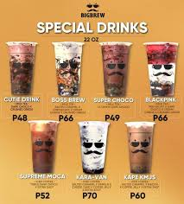
MILK TEA SHOP MANAGEMENT WITH INVENTORY SYSTEM

Slide 56
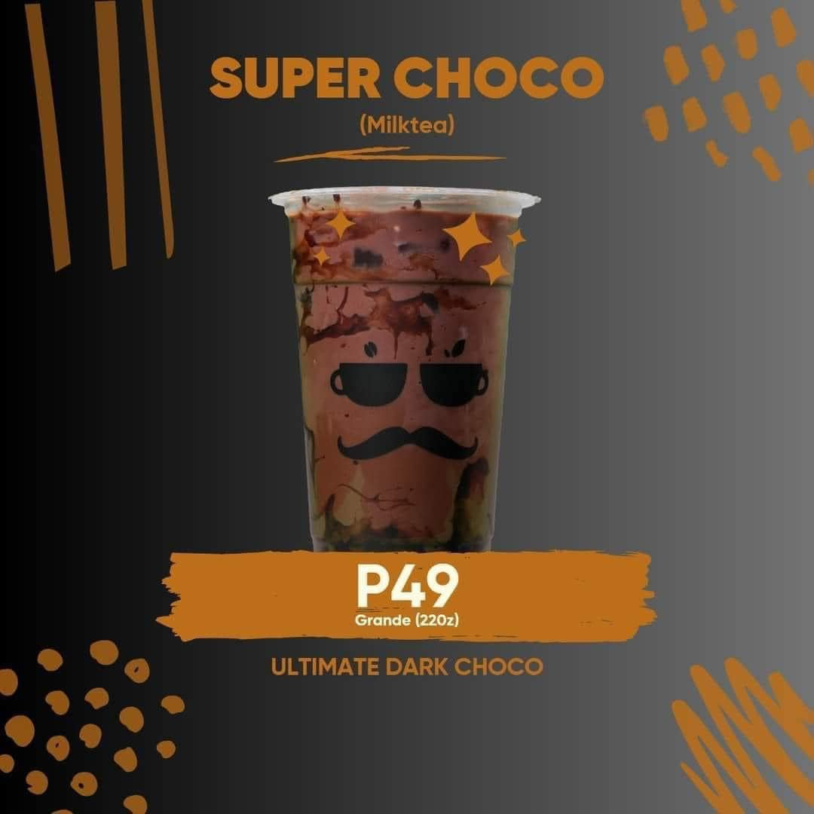
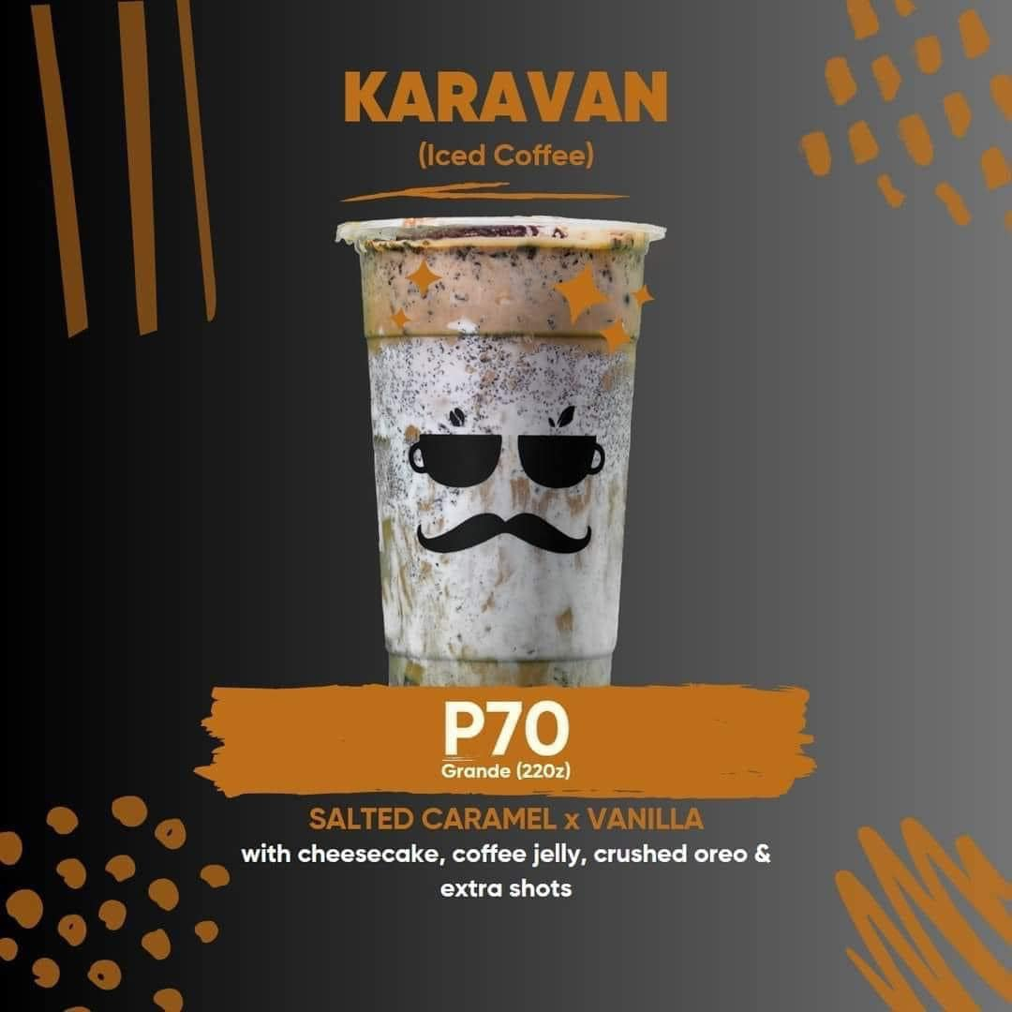
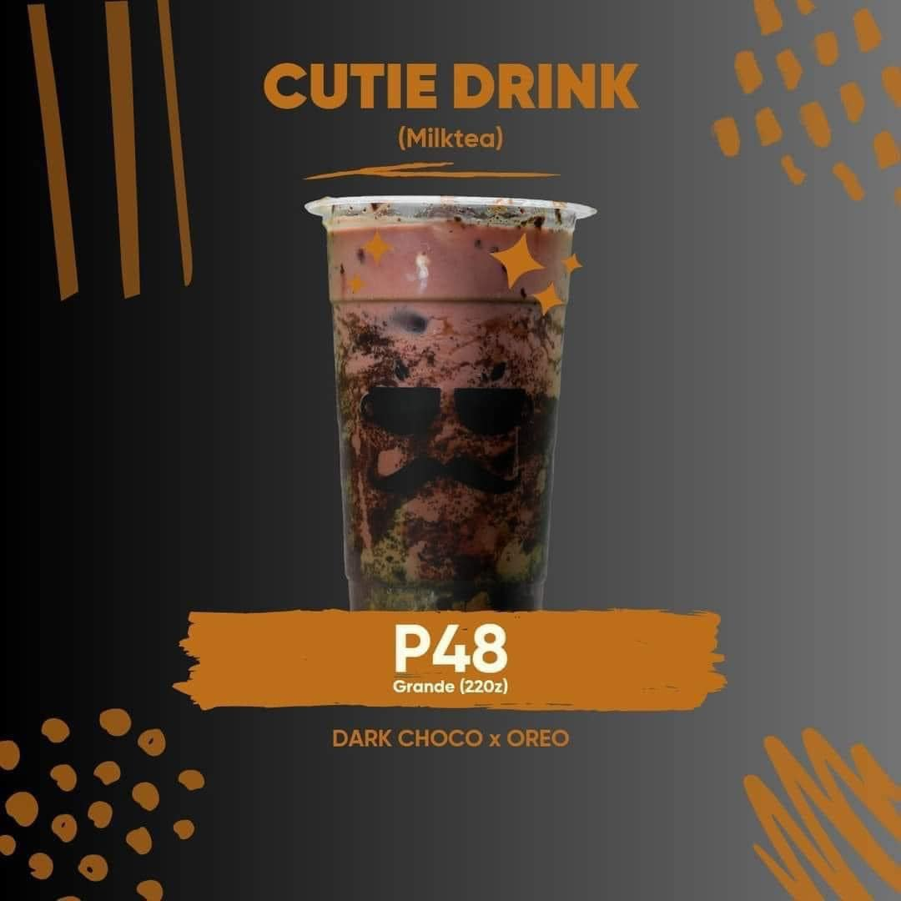
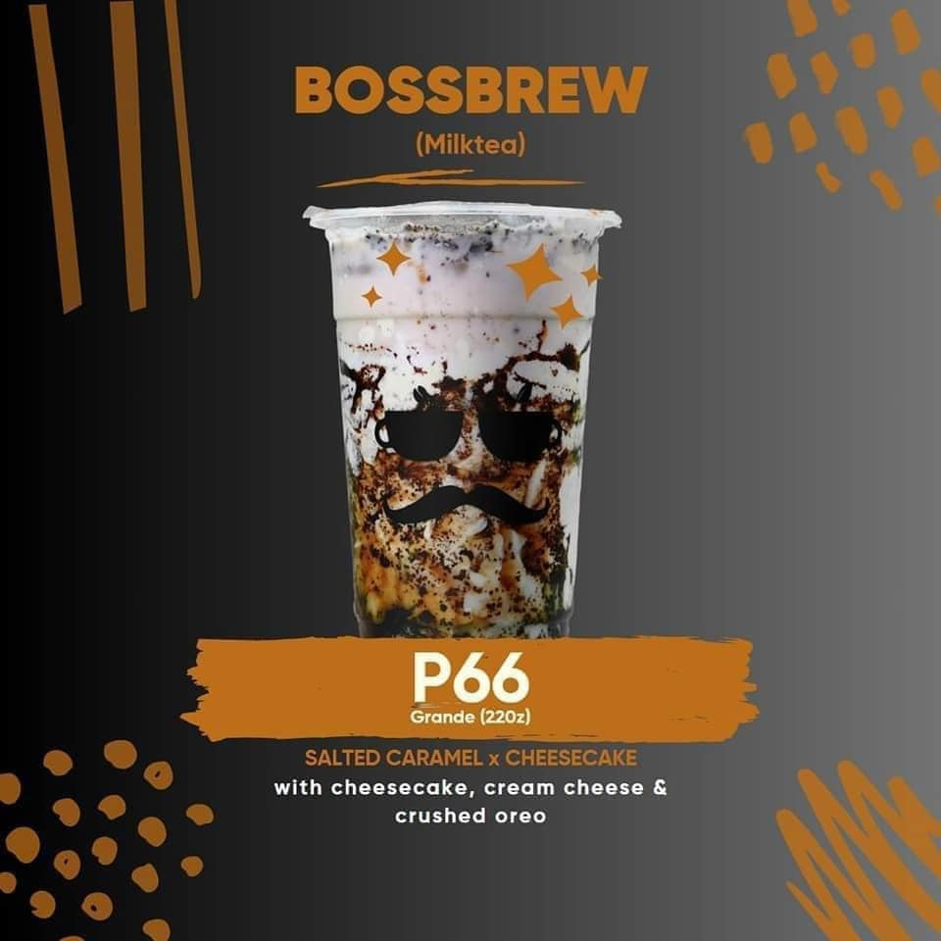
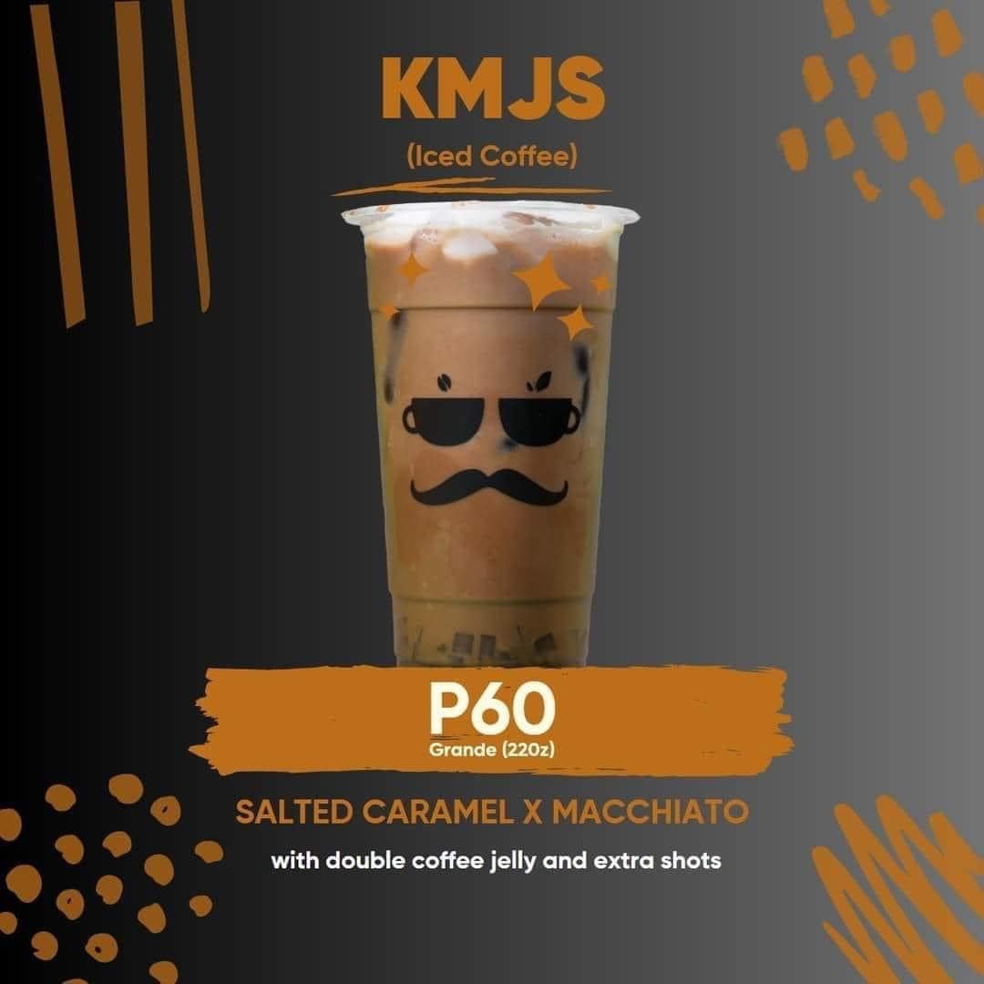
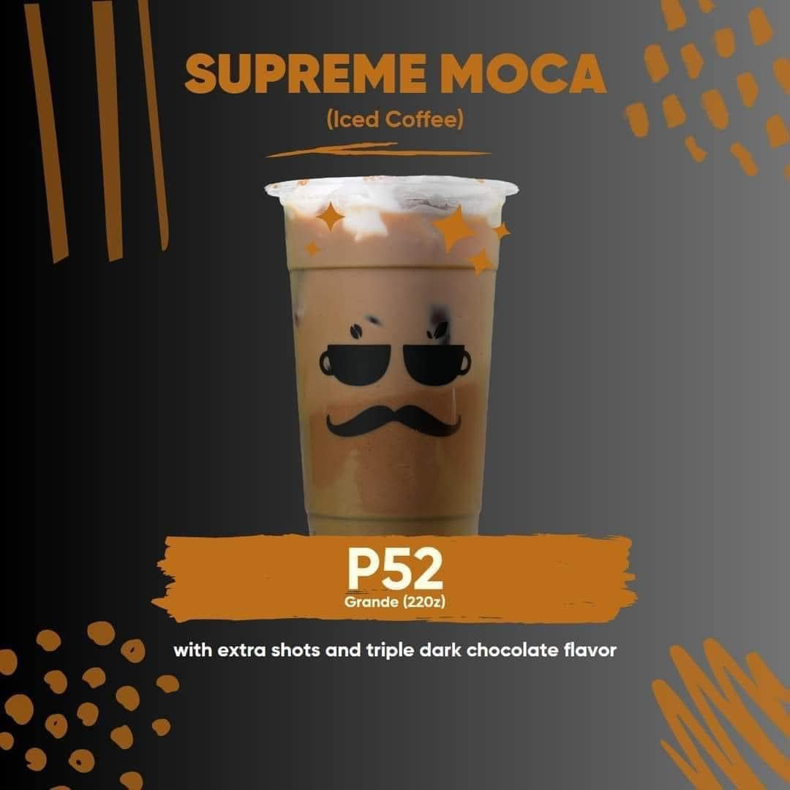
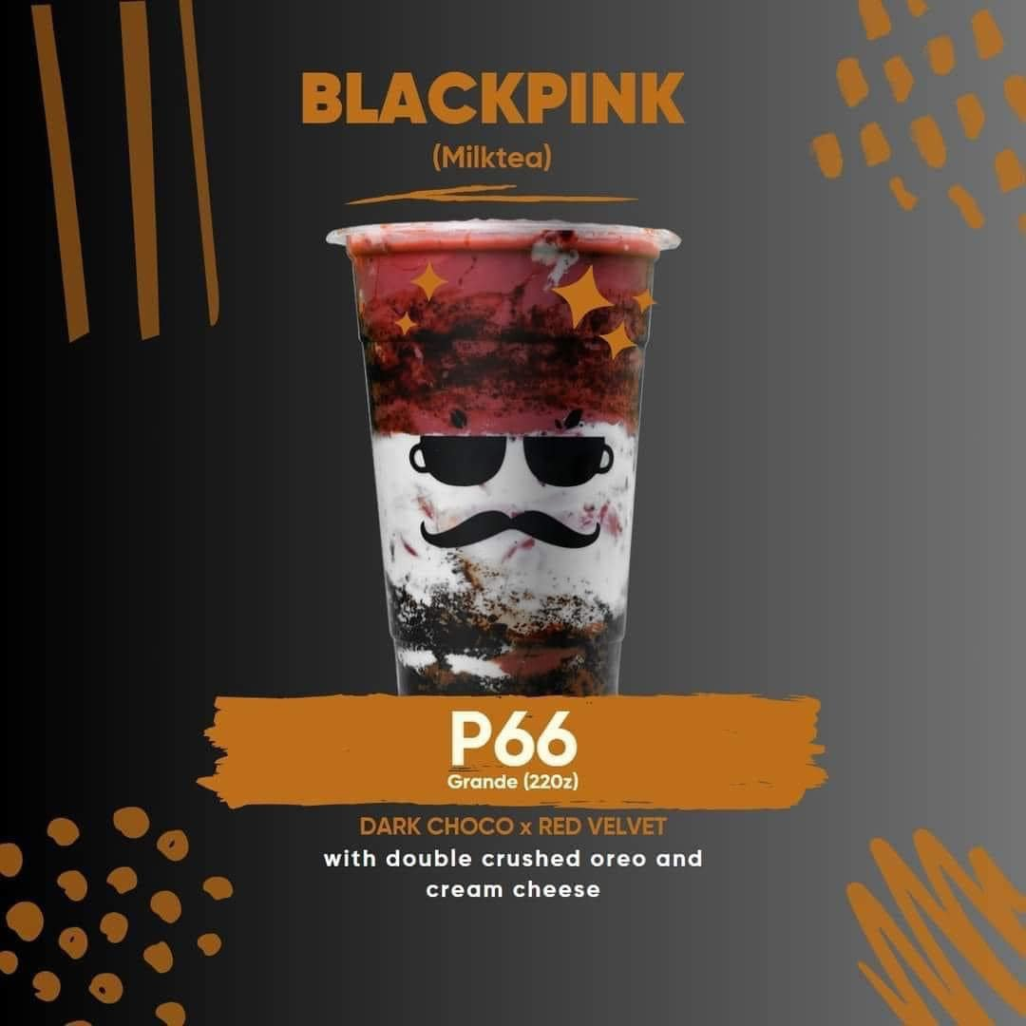
SPECIAL DRINKS

Slide 57
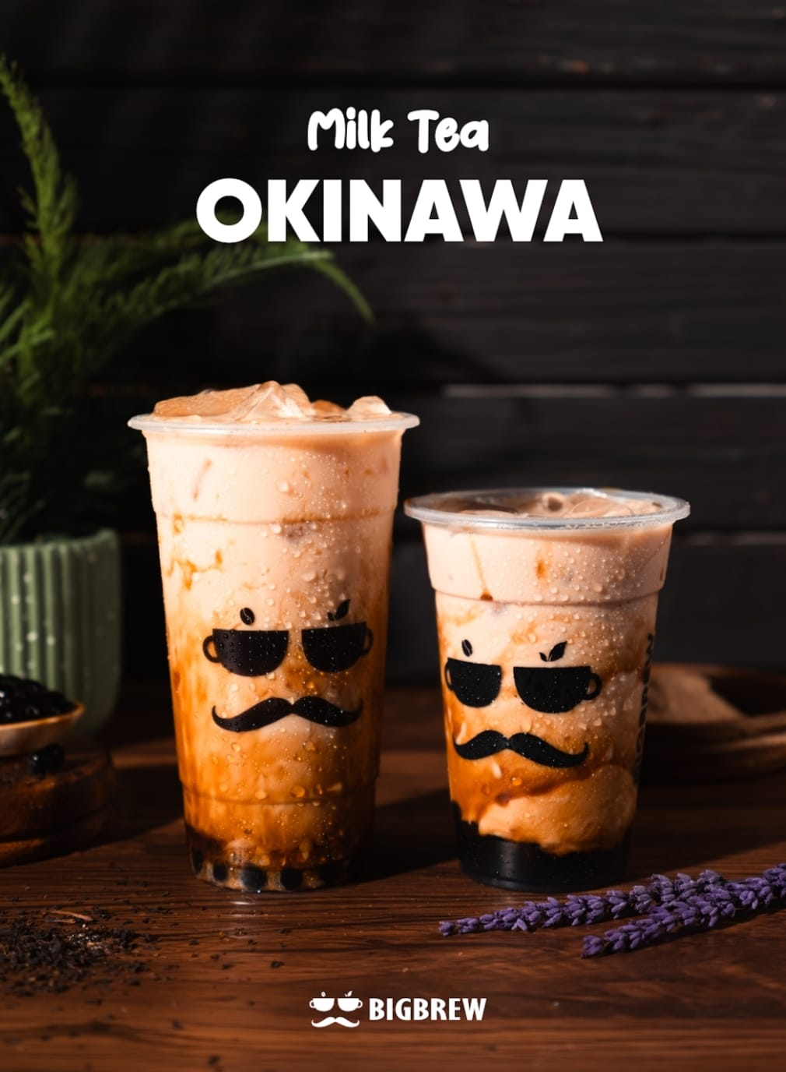
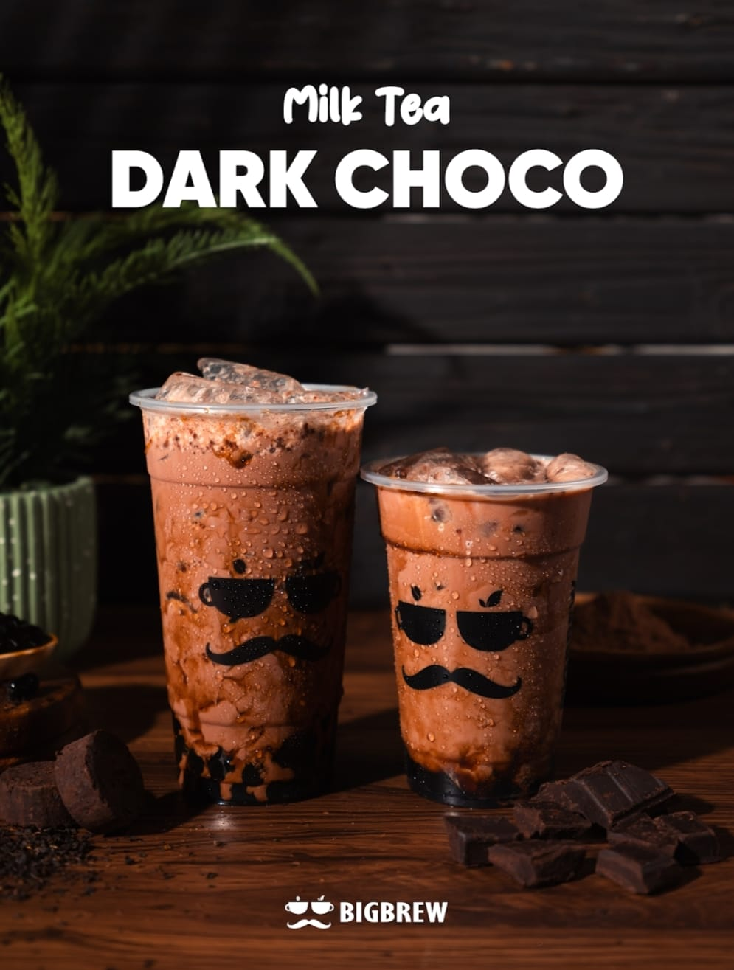
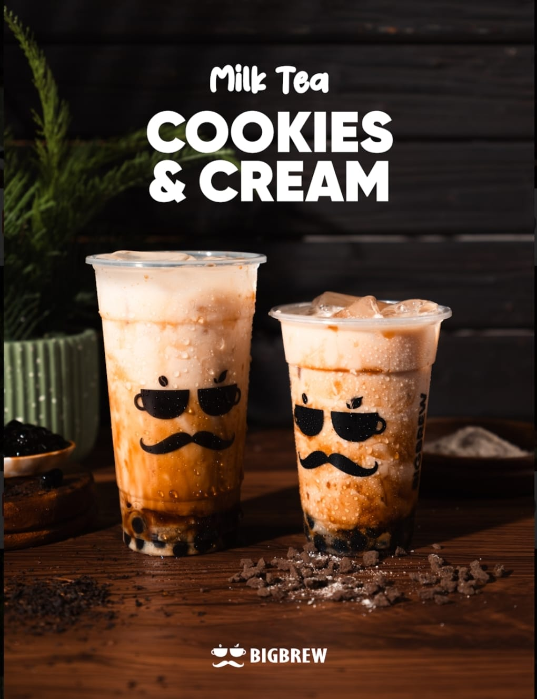
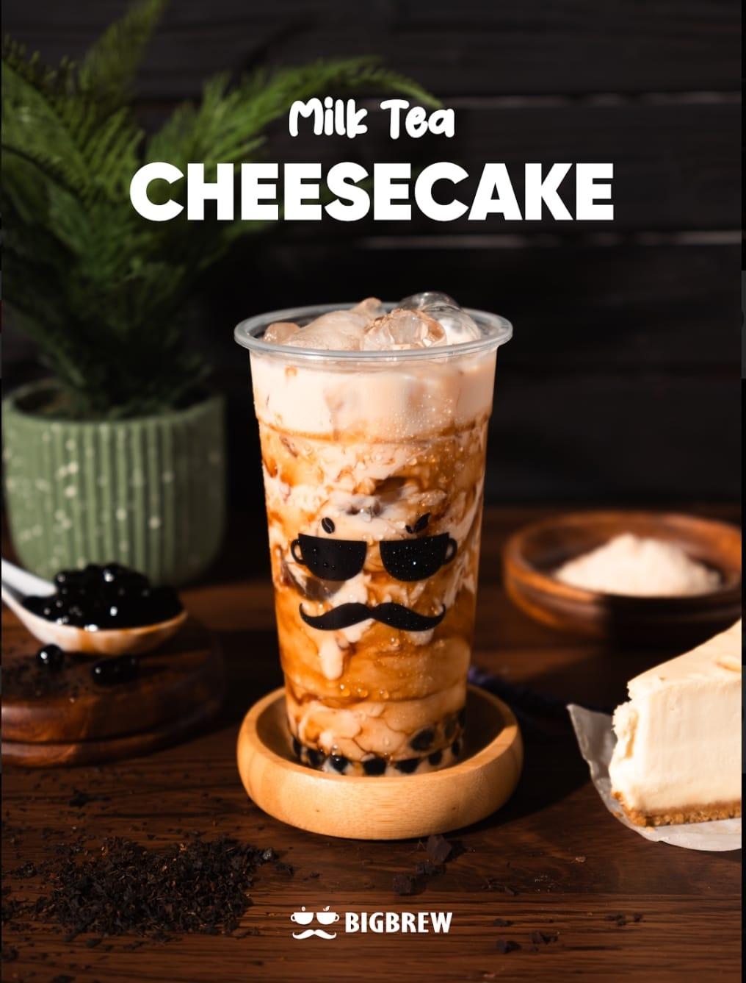
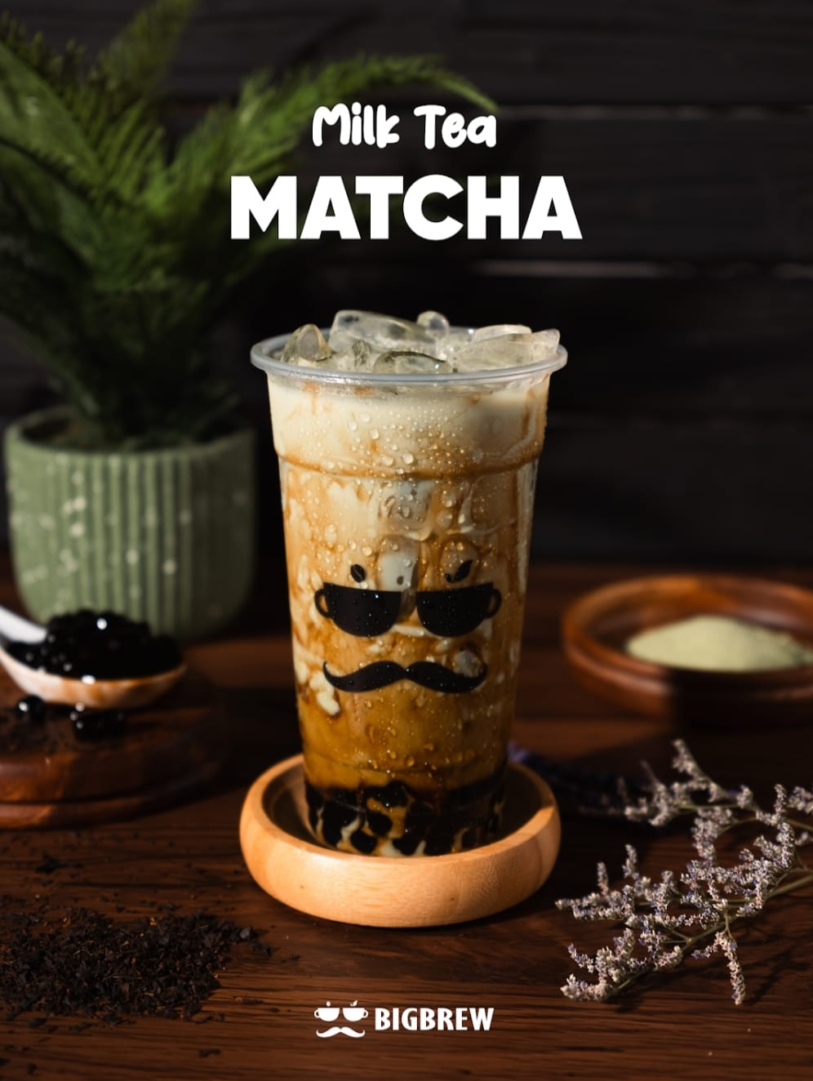
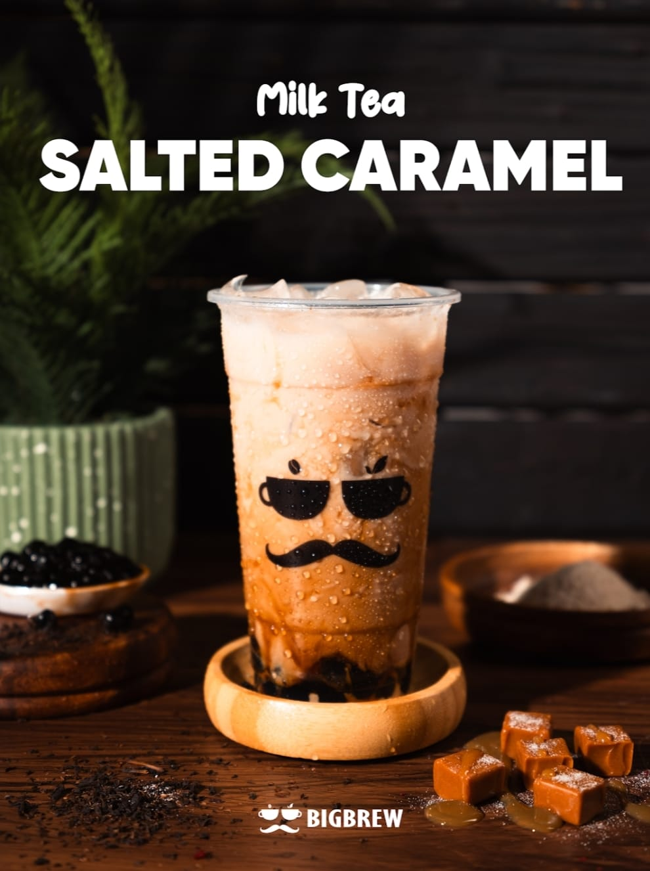
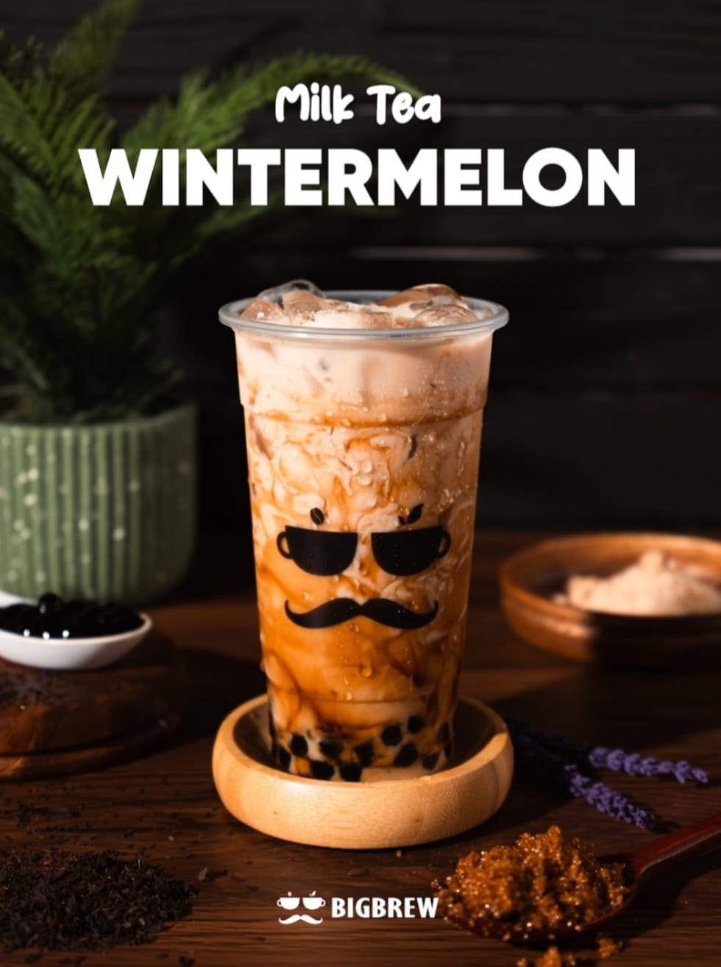
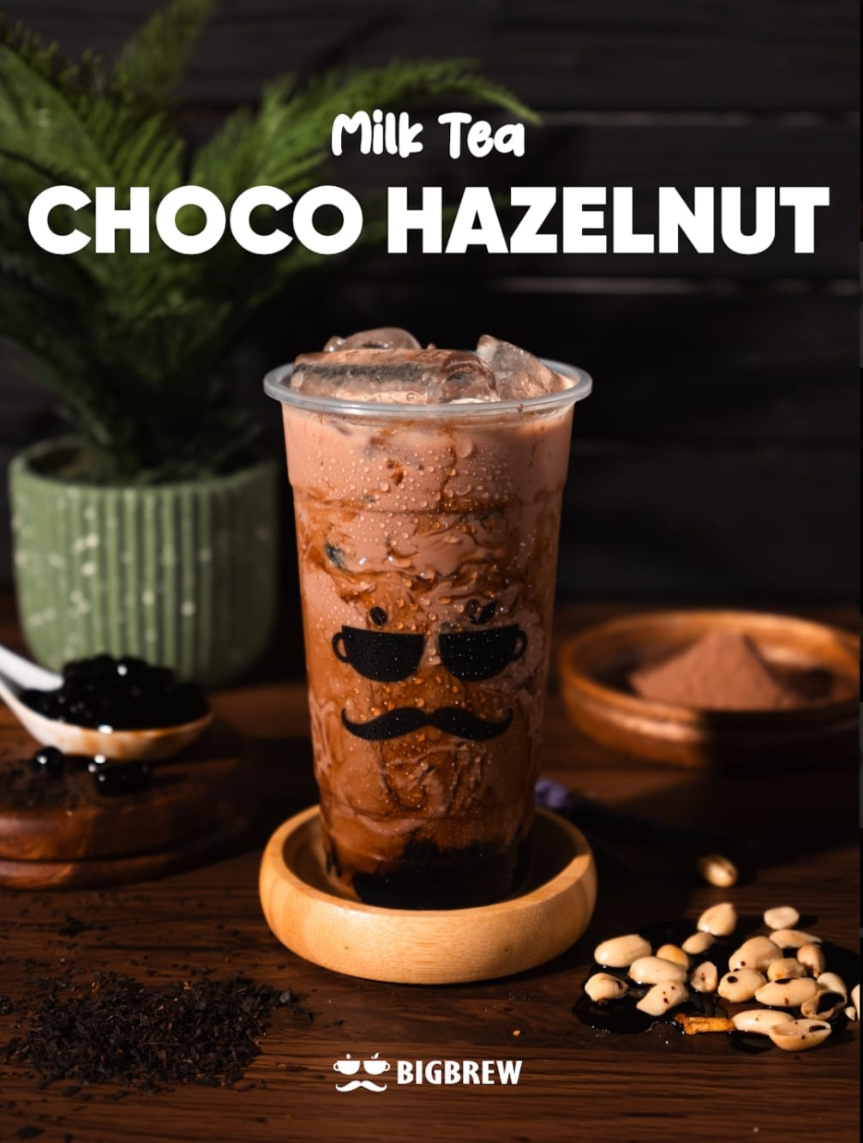
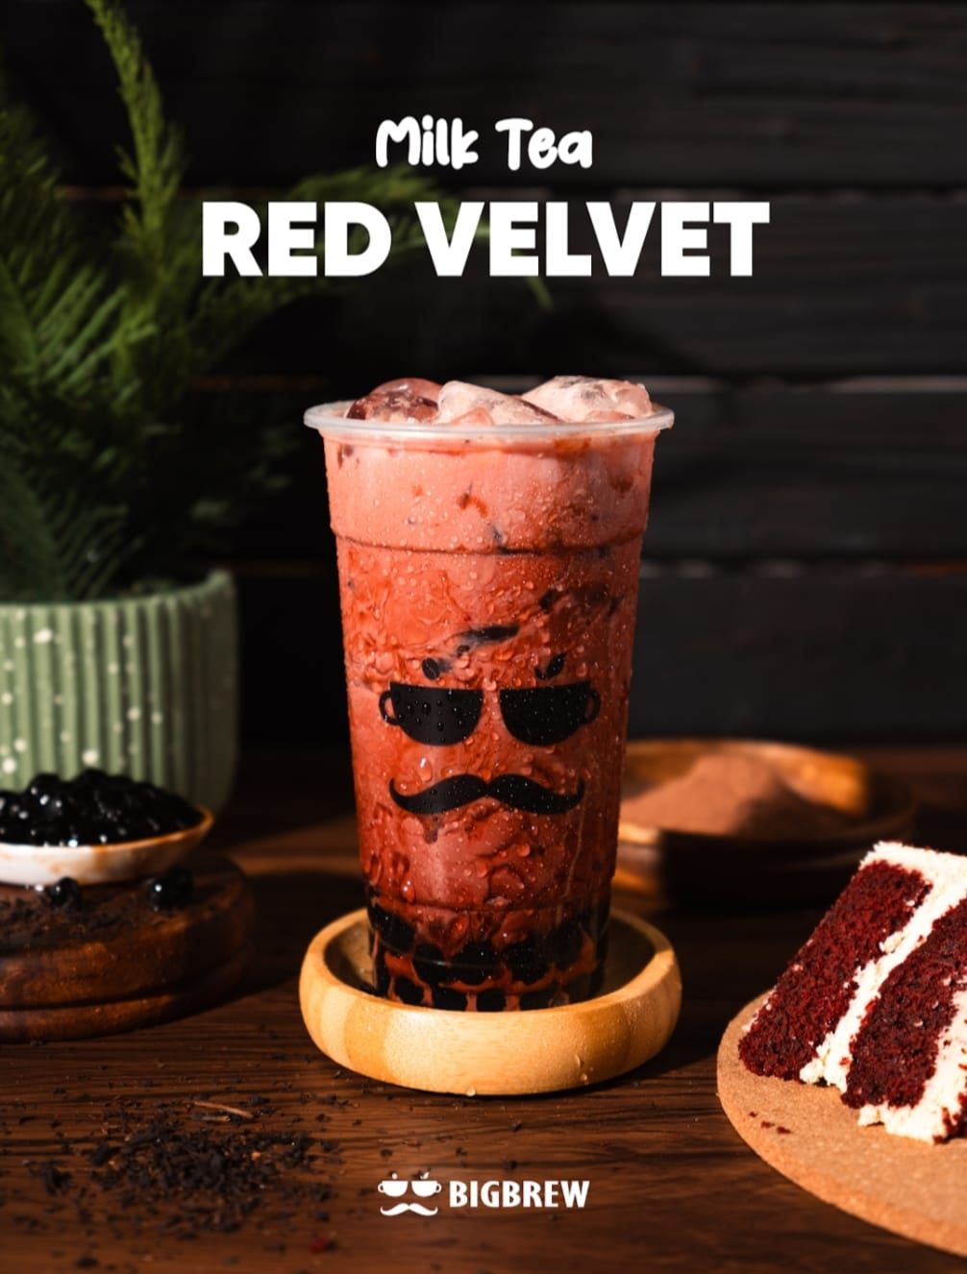
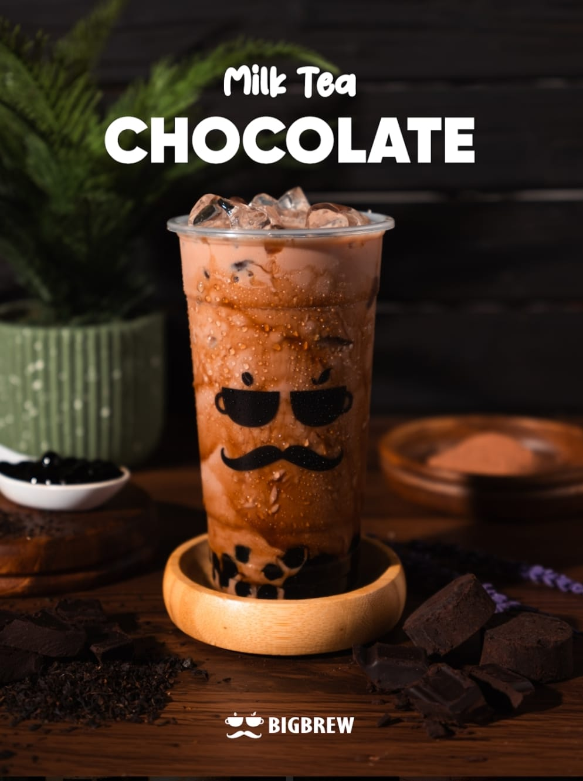
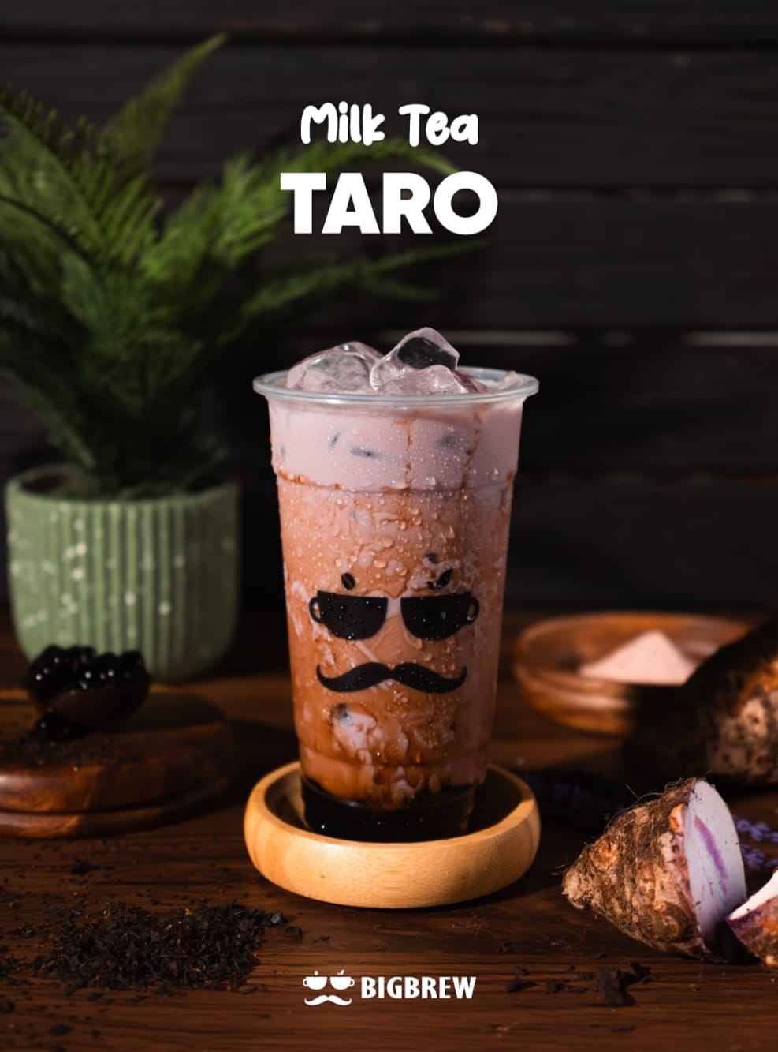
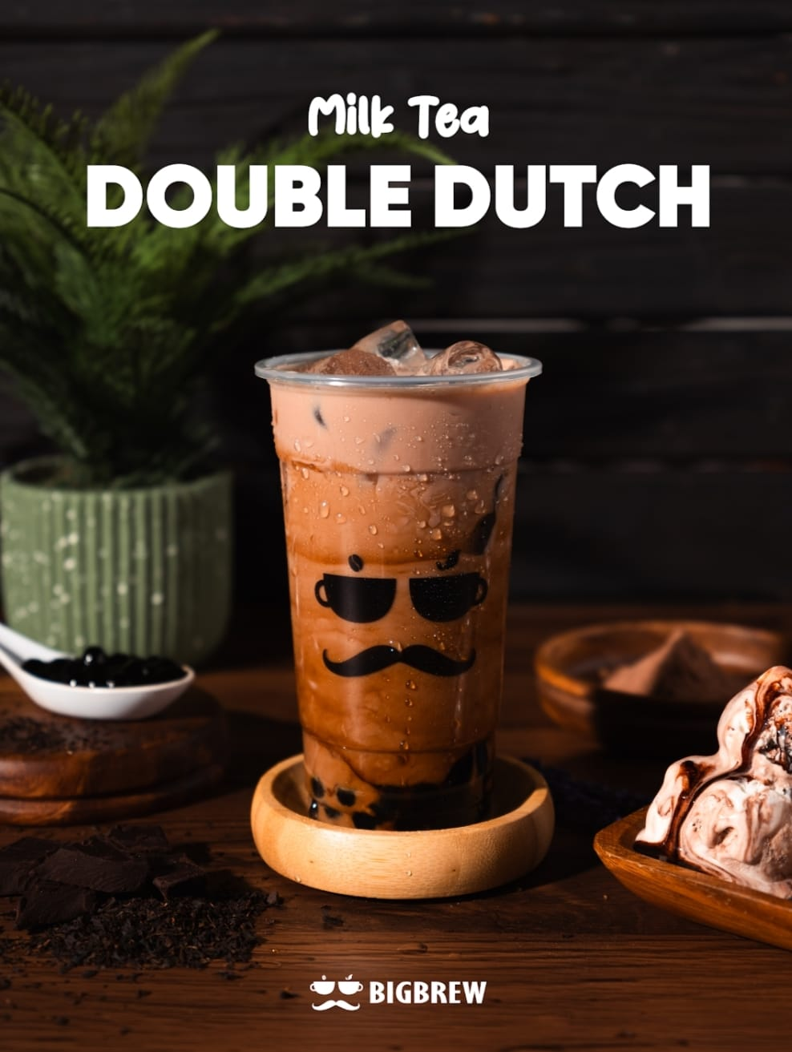
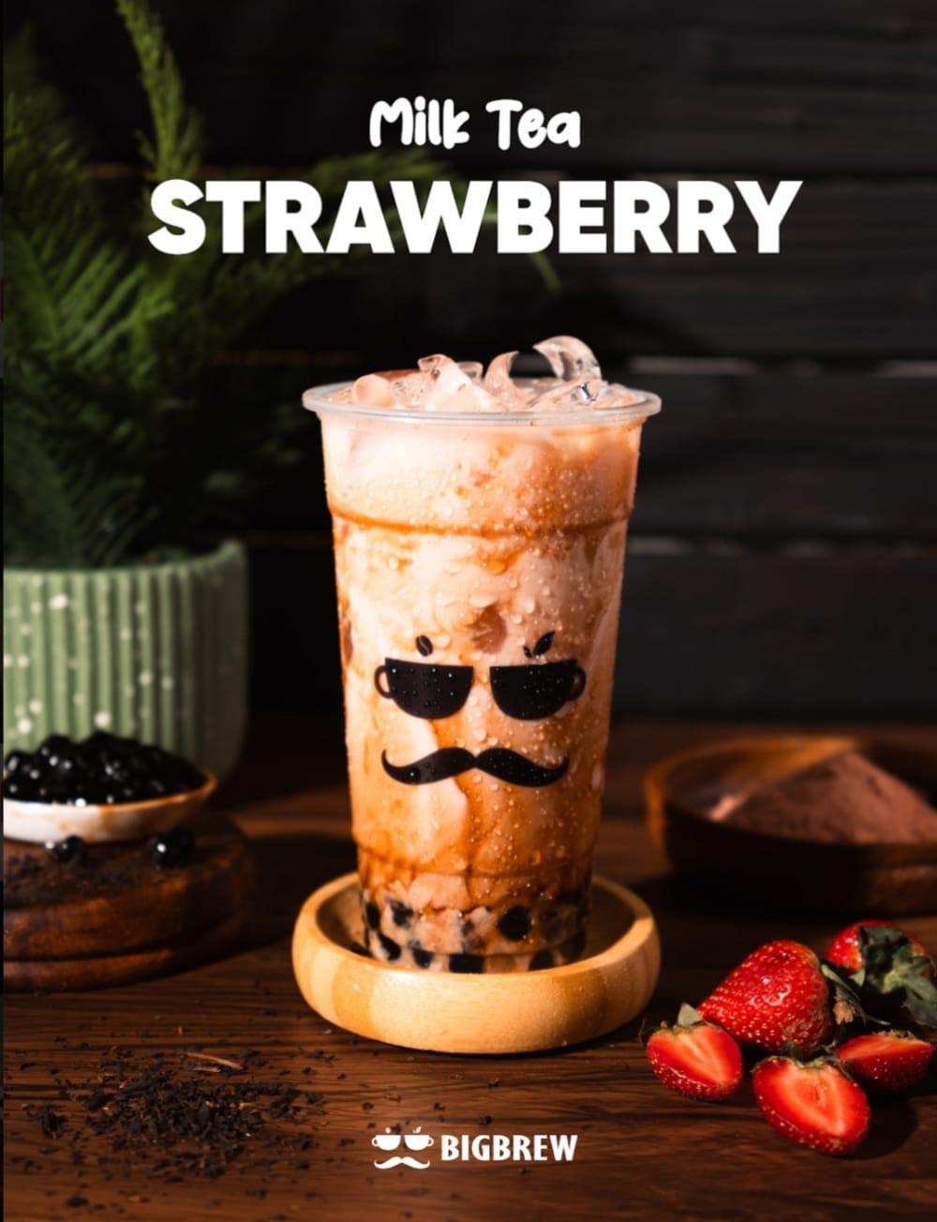
MILK TEA

Slide 58
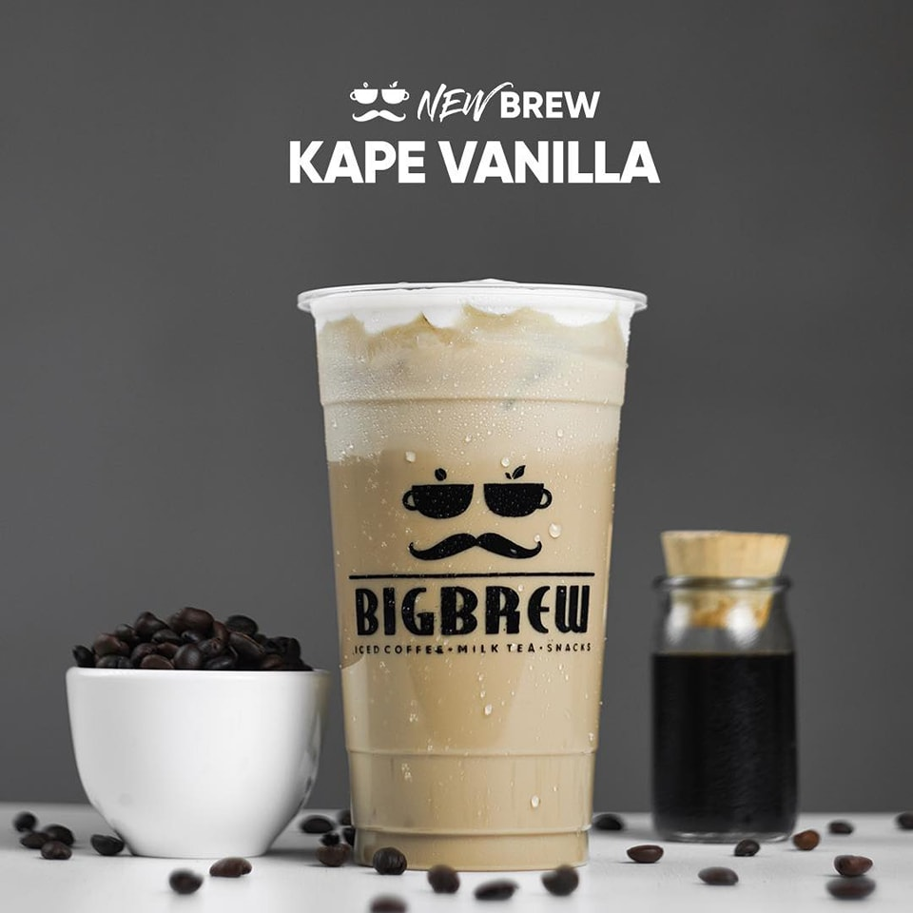



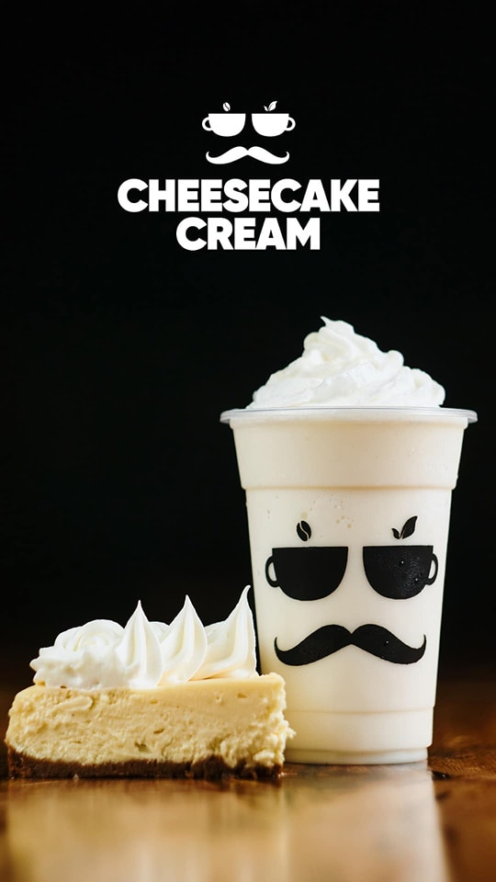
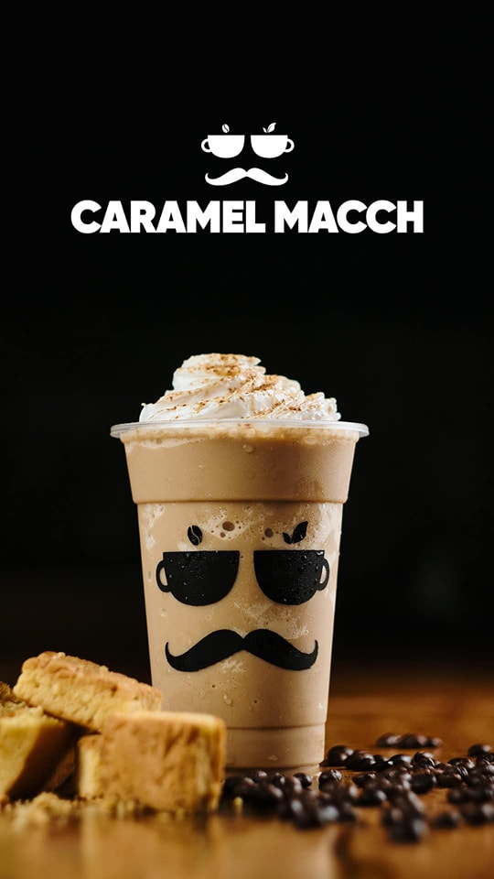
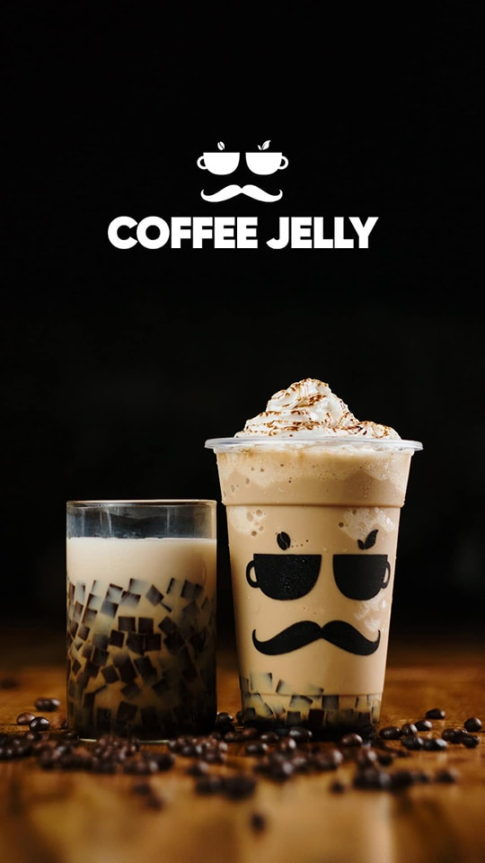
COFFEE

Slide 59


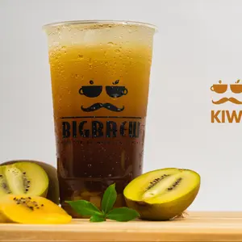
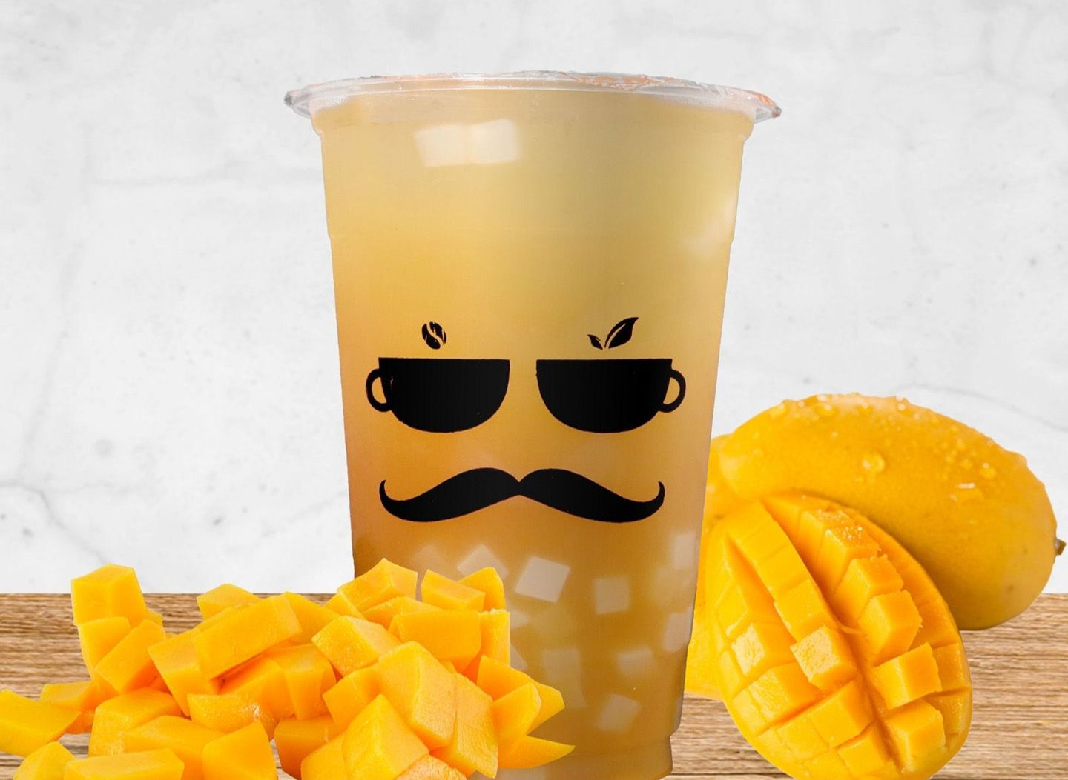


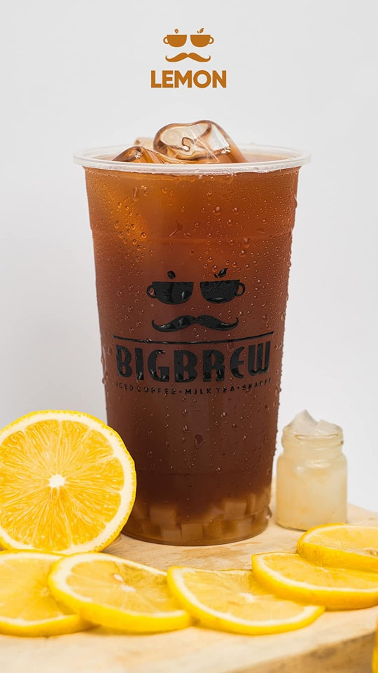
FRUIT TEA

Slide 60








BROSTY

Slide 61
Edit Order
V
Quantity: 2
Name: SUPER CHOCO
Price: Php 49.00
Size:
16oz
22oz
+
-
Sugar level:
25%
50%
75%
100%
Add to order

Slide 62
Edit Order
Quantity: 2
Name: OKINAWA
Price: Php 49.00
Size:
16oz
22oz
+
-
Sugar level:
25%
50%
75%
100%
Add to order

Slide 63
ORDER LIST
Name: SUPER CHOCO
Price: Php 49.00
Size: 22oz
Quantity: 2pcs
Sugar level: 50%
Cancel
Add order
Check Out

Slide 64
ORDER LIST
Name: SUPER CHOCO
Price: Php 49.00
Size: 22oz
Quantity: 2pcs
Sugar level: 50%
Are you sure you want to cancel ?e
Cancel
Yes
No
Add order
Check Out

Slide 65
ORDER LIST
Name: SUPER CHOCO
Price: Php 49.00
Size: 22oz
Quantity: 2pcs
Sugar level: 50%
Your order has been successfully cancelede
Cancel
OK
Add order
Check Out

Slide 66
ORDER LIST
Name: SUPER CHOCO
Price: Php 49.00
Size: 22oz
Quantity: 2pcs
Sugar level: 50%
Cancel
Name: OKINAWA
Price: Php 39.00
Size: 16oz
Quantity: 2pcs
Sugar level: 75%
Cancel
Add order
Check Out

Slide 67
ORDER LIST
Name: SUPER CHOCO
Price: Php 49.00
Size: 22oz
Quantity: 2pcs
Sugar level: 50%
Cancel
Name: OKINAWA
Price: Php 39.00
Size: 16oz
Quantity: 2pcs
Sugar level: 75%
Cancel
Add order
Check Out

Slide 68
ORDER LIST
Name: SUPER CHOCO
Price: Php 49.00
Size: 22oz
Quantity: 2pcs
Sugar level: 50%
Are you sure you want to cancel ?e
Cancel
Name: OKINAWA
Price: Php 39.00
Size: 16oz
Quantity: 2pcs
Sugar level: 75%
Yes
No
Cancel
Add order
Check Out

Slide 69
ORDER LIST
Name: OKINAWA
Price: Php 39.00
Size: 16oz
Quantity: 2pcs
Sugar level: 75%
Your order has been successfully cancelede
Cancel
OK
Add order
Check Out

Slide 70
ORDER LIST
Name: OKINAWA
Price: Php 39.00
Size: 16oz
Quantity: 2pcs
Sugar level: 75%
Cancel
Add order
Check Out

Slide 71
ORDER LIST
Name: SUPER CHOCO
Price: Php 49.00
Size: 22oz
Quantity: 2pcs
Sugar level: 50%
Are you sure you want to cancel ?e
Cancel
Name: OKINAWA
Price: Php 49.00
Size: 16oz
Quantity: 2pcs
Sugar level: 75%
Yes
No
Cancel
Add order
Check Out

Slide 72
ORDER LIST
Name: SUPER CHOCO
Price: Php 49.00
Size: 22oz
Quantity: 2pcs
Sugar level: 50%
Your order has been successfully cancelede
Cancel
OK
Add order
Check Out

Slide 73
ORDER LIST
Name: SUPER CHOCO
Price: Php 49.00
Size: 22oz
Quantity: 2pcs
Sugar level: 50%
Cancel
Add order
Check Out

Slide 74
CHOOSE PAYMENT METHOD
PAY AT THE COUNTER
G-CASH

Slide 75


Slide 76
ORDER NUMBER
2471

Slide 77
2471
Type Dine In
Name Num Price
Super Choco 2 39
Okinawa 2 39
Product amount 156
Total Amount 156
Cash 156
Order Time 11-09 15:00
Print Time 11-09 15: 00
Thank you for ordering!!

Slide 78
2471
Type Dine In
Name Num Price
Super Choco 2 39
Okinawa 2 39
Product amount 156
Total Amount 156
G-Cash 156
Order Time 11-09 15:00
Print Time 11-09 15: 00
Thank you for ordering!!

